Slide 1

Of CORS It’s Exploitable!
Rebecca Deck, GSE, OSCE, CISSP
@ranger_cha
BE INFORMED. BE STRATEGIC. BE SECURE.

Slide 2
OVERVIEW
REST & CORS Overview
CORS Bypasses
CORS & Scanners
Multi-step CORS Exploits
CORS Defenses

Slide 3

WHAT IS REST?
REpresentational State Transfer
Often uses extra HTTP methods
6 factors people don’t always use
Common API Type
Microservices
Model-View-Controller
Data can be in various formats
JSON, XML, YAML

Slide 4
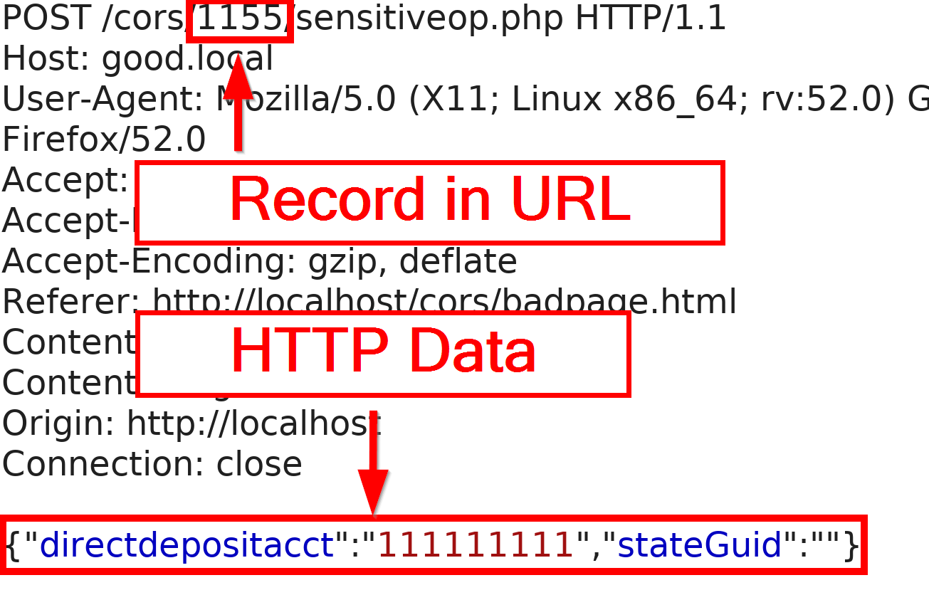
WHAT IS REST?

Slide 5

REST AUTHENTICATION
Not just cookies for session management
Multiple forms, sometimes used together
Cookies
Bearer Header
Custom Headers

Slide 6
WHAT IS A CROSS-ORIGIN REQUEST?
Sometimes web content and APIs are on different servers
XHR (XML HTTP Request) between sites
Content on site A makes users send requests to site B
Force a user to change their email address
Send request to internal server
Sounds an awful lot like cross-site request forgery (CSRF)

Slide 7
WHAT IS CORS?
Browser protection
Defined in Fetch spec
Very granular
Generally more complex than tokens
Easy to misconfigure

Slide 8
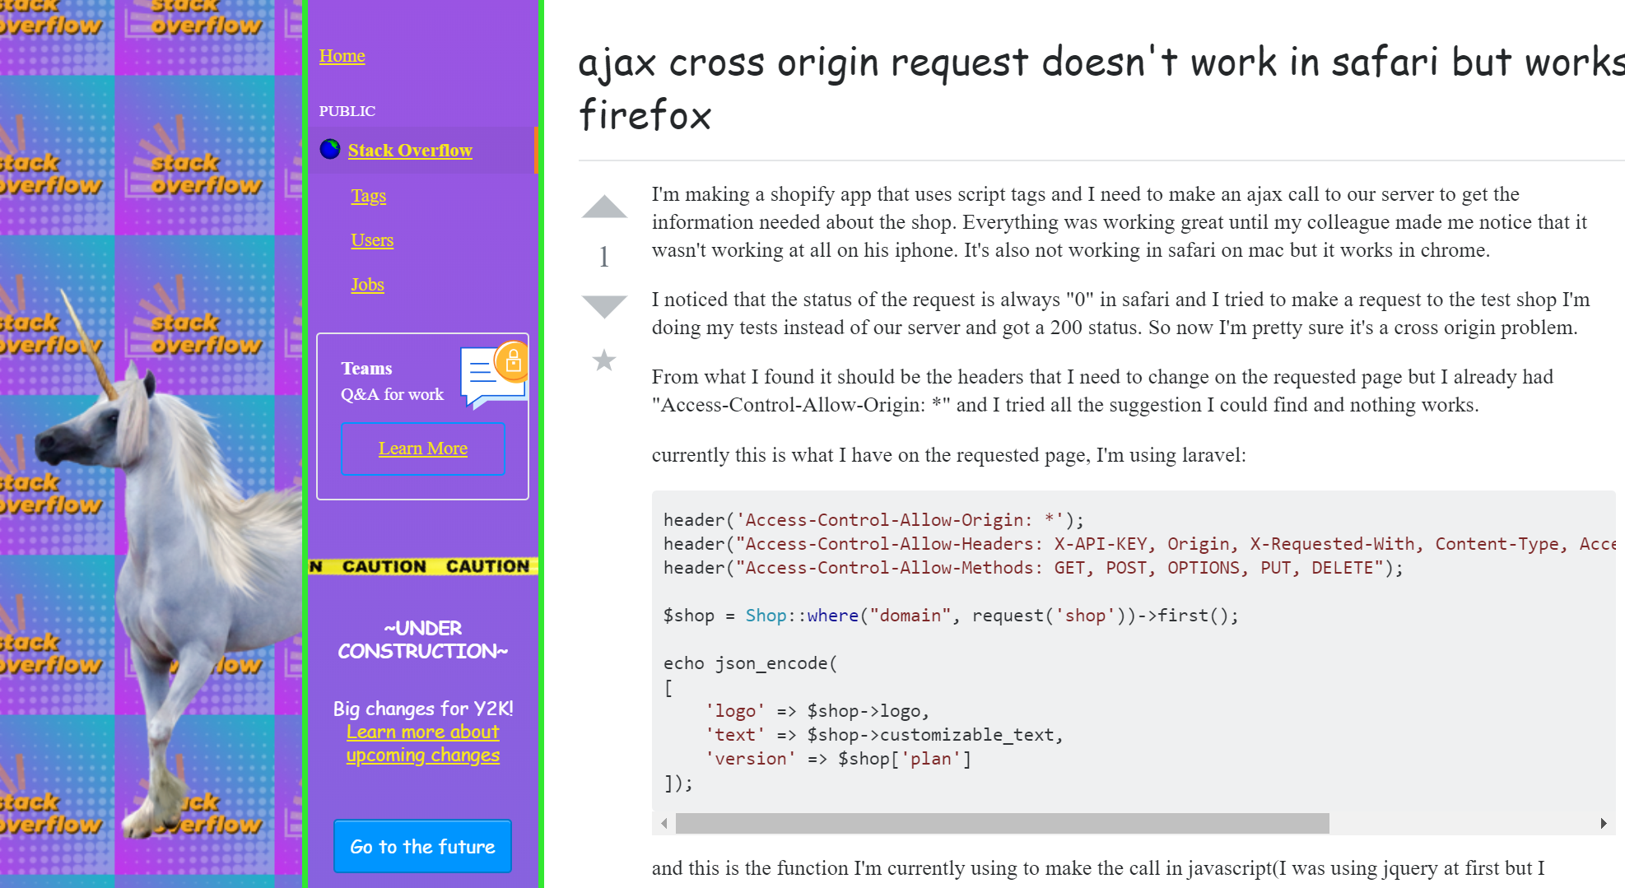

Slide 9
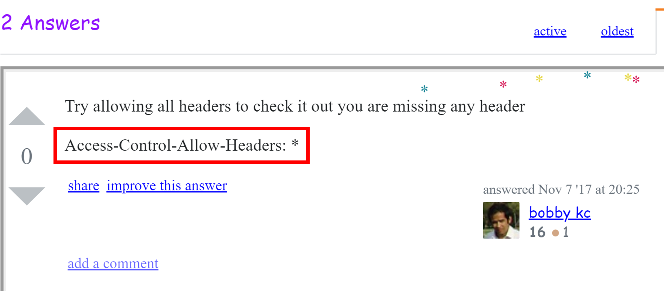

Slide 10
CORS DETAILS
Browser sends pre-flight request (OPTIONS)
Server sends response
Client decides if the full request is permitted
Client sends full request if permitted

Slide 11

CORS DETAILS
Client
Pre-flight Options
Server
CORS Headers
Actual Request
Actual Response

Slide 12
CORS REQUEST HEADERS
Origin
Access-Control-Request-
Method
Headers

Slide 13
CORS RESPONSE HEADERS
Access-Control-Allow
Origin (ACAO)
Credentials
Methods
Headers
Access-Control-Expose-Headers
Access-Control-Max-Age

Slide 14
BYPASSING CORS Origin
Origin controls where requests come from
Fundamental to CORS security
ACAO Supports wildcards & exact matches
*
Only for open APIs
https://www.good.local

Slide 15
BYPASSING CORS Origin
Access-Control-Allow-Credentials
Send cookies
Send Authorization (basic & NTLM)
Does not support wildcards in origin
Often parrots origin header
Hard to do check origin for on-prem apps
Otherwise, uses regex
May be wrong

Slide 16
BYPASSING CORS Origin Examples
Regex | Bypass with
.* | Literally anything
good.local | goodalocal.evil.local
^.*good\.local | good.local.evil.local

Slide 17
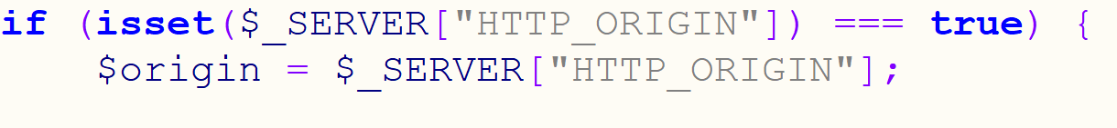
BYPASSING CORS Bad Origin Example Code

Slide 18
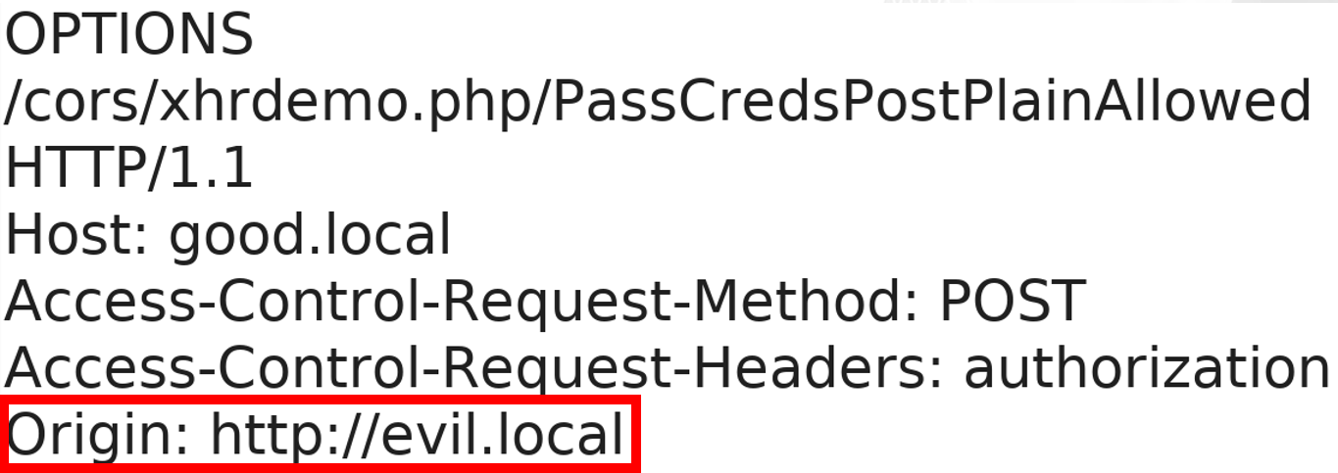
BYPASSING CORS
Client
Pre-flight
Server

Slide 19
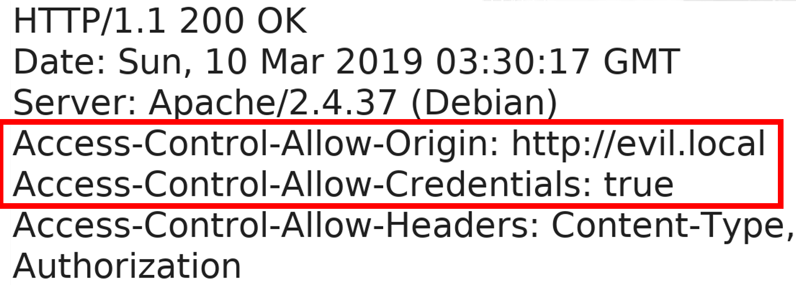
BYPASSING CORS
Client
Pre-flight Response
Server

Slide 20
BYPASSING CORS Avoiding Pre-flight Requests
Simple requests
GET, HEAD, or POST
A few headers
Content-Type
application/x-www-form-urlencoded
multipart/form-data
text/plain

Slide 21
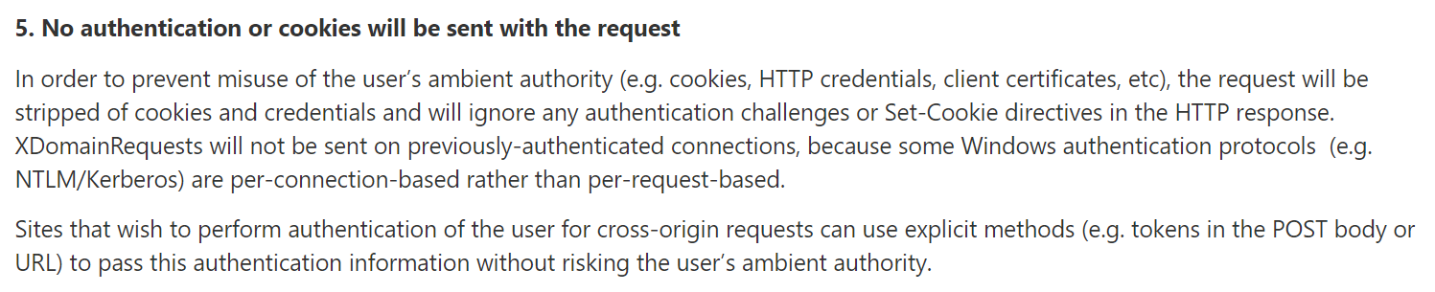
BYPASSING CORS Avoiding Pre-flight Requests
https://blogs.msdn.microsoft.com/ieinternals/2010/05/13/xdomainrequest-restrictions-limitations-and-workarounds/

Slide 22
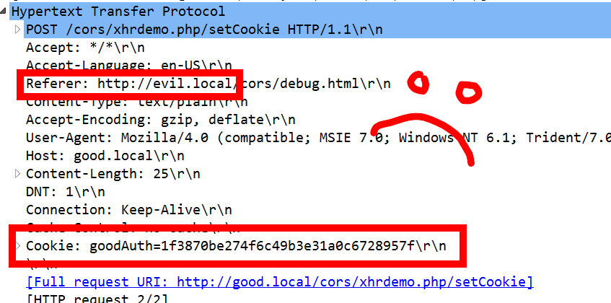
BYPASSING CORS Avoiding Pre-flight Requests
(╯°□°）╯︵ ┻━┻

Slide 23
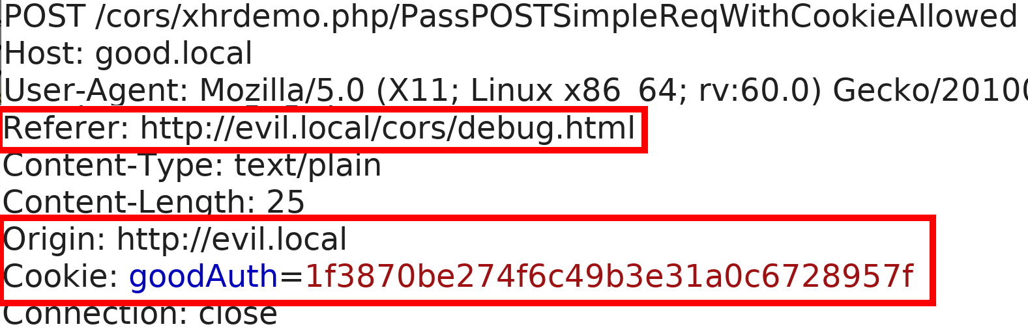
BYPASSING CORS Avoiding Pre-flight Requests Examples
Client
POST
Server

Slide 24
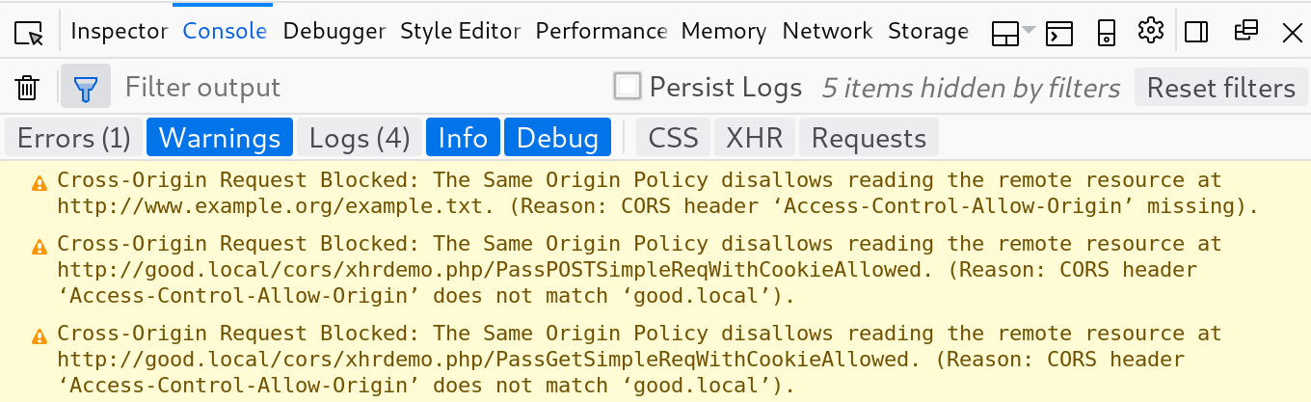
BYPASSING CORS Avoiding Pre-flight Requests Examples

Slide 25
COMMON CORS PITFALLS BY TESTERS
Scanners are pretty sad
Over-reliance on Origin
Ignoring custom headers
Forget the pre-flight
Don’t modify multiple parts of the request
Customers think we are wrong
Thinking we’re limited to one request
Think GUIDs protect them

Slide 26

MULTI-STEP CORS EXPLOITS
“Attackers won’t know your GUID so this won’t work”
Only so long as GUIDs are secret

Slide 27
MULTI-STEP CORS EXPLOIT EXAMPLE
Software handling financial payments
GET to REST API to list all accounts
POST to REST API to update direct deposit
Reflected Origin header
Session cookie to handle authentication
Used WithCredentials on XHR

Slide 28
MULTI-STEP CORS EXPLOIT EXAMPLE
Three-step exploit
Request list of accounts
Parse JSON to retrieve account info
POST to update direct depost
Scanner finding (from Burp)
CORS Arbitrary Origin Trusted

Slide 29
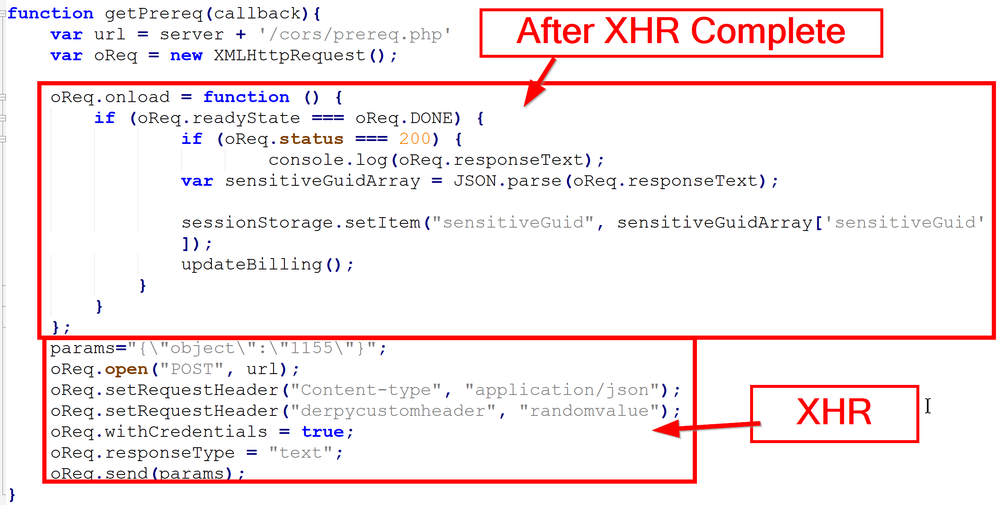
MULTI-STEP CORS EXPLOIT EXAMPLE

Slide 30
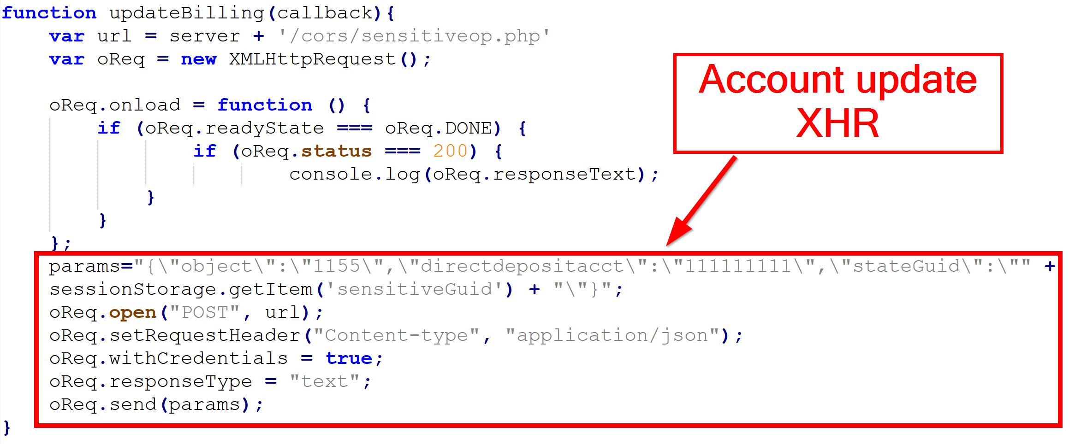
MULTI-STEP CORS EXPLOIT EXAMPLE

Slide 31
CORS DEFENSES
Nonce Tokens
Origin Header
Limit as much as possible
Use regex and whitelists
Custom Headers

Slide 32
DO AUTHORIZATION HEADERS HELP?
Sites with access to token must have no XSS
Token must be unpredictable
Token must be unique per user
Receiving system must validate token
Attacker must not be able to generate tokens for another user
Apps must never put the token in an insecure place (URL)

Slide 33
SUMMARY
CORS secures XHR requests
Origin is important!
Attack with “simple” requests
Multi-step attacks are possible!

Slide 34
RESOURCES
Portswigger CORS
https://portswigger.net/blog/exploiting-cors-misconfigurations-for-bitcoins-and-bounties
Mozilla CORS Info
https://developer.mozilla.org/en-US/docs/Web/HTTP/CORS
W3C CORS
https://www.w3.org/TR/cors/

Slide 35
RESOURCES
Fetch Spec
https://fetch.spec.whatwg.org/
Example XHR Code
https://github.com/rangercha/CORSRequestPOC
CORS Exploitation Framework (not out)
Detailed CORS Simple Requests Research
https://research.aurainfosec.io/same-origin-policy/

Slide 36
www.directdefense.com

